Slide 1
Marketing And Retail Analysis PROJECT MODULE - Ii
NAME : SHOUNACK MANDAL
COURSE: PGP - DSBA Online Sep.
Date: 26/ June / 2022

Slide 2
CONTENT OF THE PRESENTATION
Problem Statement and Agenda
Exploratory Analysis
Use of Market Basket Analysis (Association Rules)
Write about threshold values of Support and Confidence
Associations Identified
Put the associations in a tabular manner
Explain about support, confidence, & lift values that are calculated
A suggestion of Possible Combos with Lucrative Offers
Write recommendations
Make discount offers or combos (or buy two get one free) based on the associations and your experience

Slide 3
Problem statement
A Grocery Store shared the transactional data with you. Your job is to identify the most popular combos that can be suggested to the Grocery Store chain after a thorough analysis of the most commonly occurring sets of menu items in the customer orders.
agenda
As the Store doesn’t have any combo meals. So lets provide various recommendations and suggestions with the popular combo offers and discounts for customers through which the grocery store can increase its revenue.

Slide 4
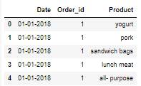

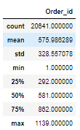
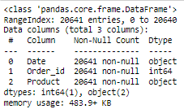
Exploratory Analysis
1. Data head
4. Data in unique
DESCRIPTION:-
The data collection of 2 years 2 months on the various products ordered from an grocery store.
Data has 20641 rows and 3 columns. With 2 object and one integer data type.
Data doesn`t have any null values.
The number of unique values are 603 for date, 1139 of order id and 37 products.
Hence the products are duplicated as because of reordered having 4730 duplicates.
5. Data Description
2. Data shape
3. Data Info
6. Duplicates

Slide 5
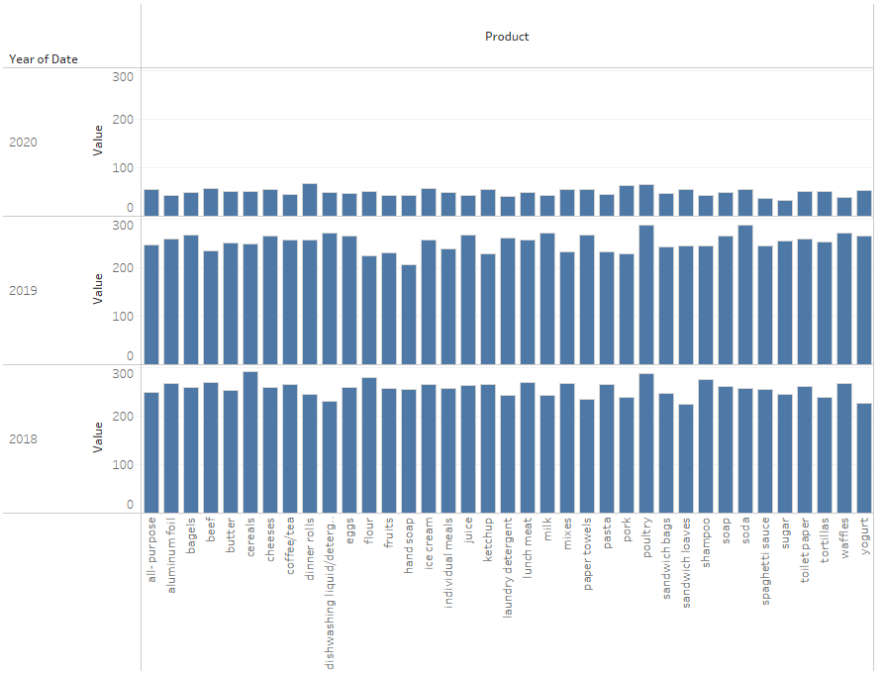
Exploratory Analysis
Yearly Trends along with products:-

Slide 6
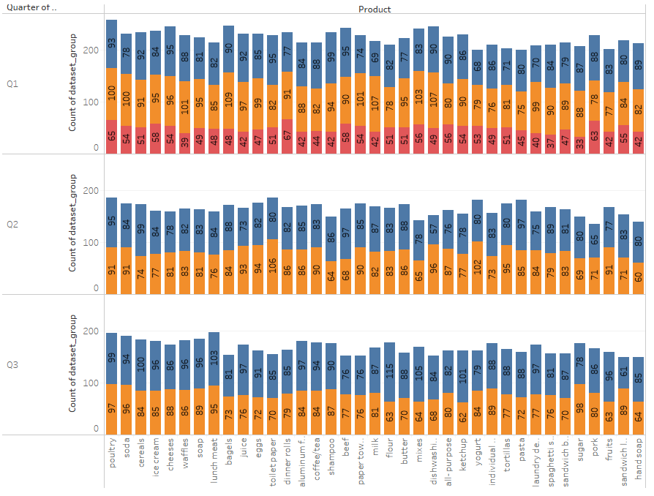

Exploratory Analysis
Quarterly trends along with products:-

Slide 7

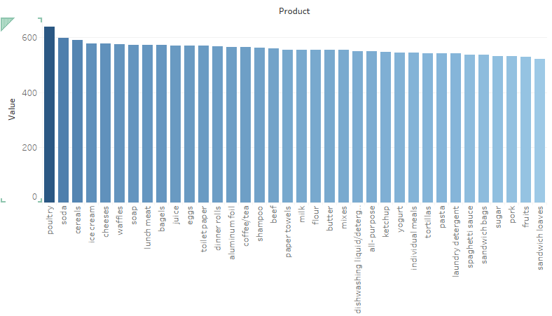
Exploratory Analysis
Product Ordered :-

Slide 8
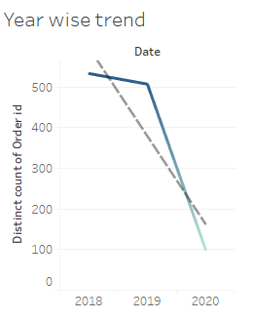
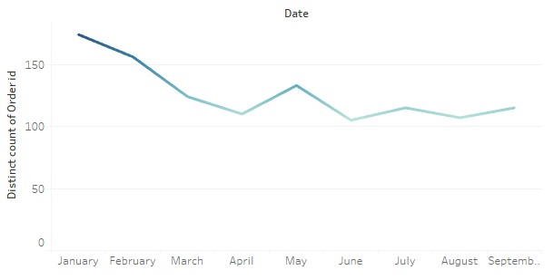
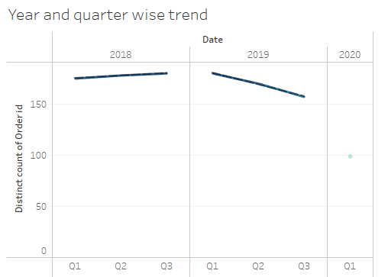
Exploratory Analysis
Year and date wise trend of distinct counts
for orders :-
Month wise we can se the trend is downward, highest orders place in the month of January and lowest orders placed by the ends months(June to September).
Year wise the sales is gradually decreasing. Lease orders places in 2020 as only 99. The other reason could be insufficient amount if data in the year 2020.
In the year of 2018 there is increase in sales quarter wise, followed by gradual decrease in sales in 2019 and 2020 has insufficient data in record.

Slide 9
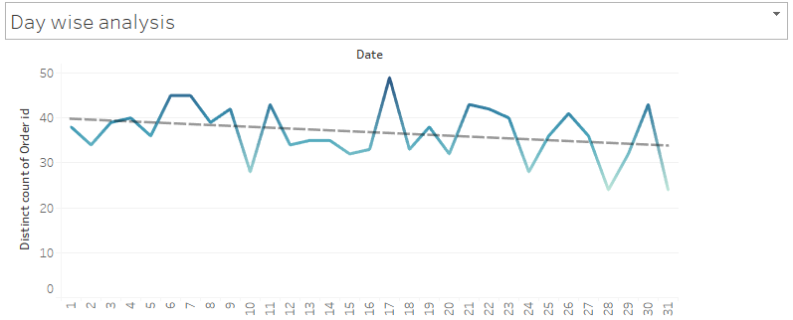

Exploratory Analysis
Date wise trend of distinct counts for orders :-
In the mid of the months i.e., 17th of every month has the highest number of trend.

Slide 10
Use of Market Basket Analysis (Association Rules)
A market basket analysis is a data-mining technique that analysts use to look for relationships between items in a data set to identify trends and patterns.
Typically, a market basket analysis shows which items customers frequently buy together, which helps analysts predict what new customers may purchase.
Association Rules
Association Rules are one of the prime scenario where anticipation of customer behavior can be done by identifying frequent patterns in a transaction database, relational databases or any other information repository.
Support, confidence level, and lift are the three measures used to compute it.
You can expect higher return rates if you have more confidence.
The strength of the relationship between the products on the antecedents and consequents columns of the association is summarised by lift.
Larger the lift, greater the link between the two products.

Slide 11
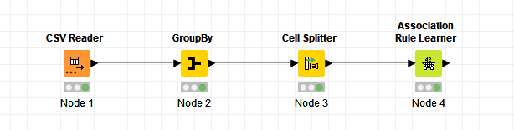
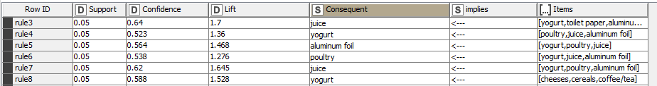
Use of Market Basket Analysis (Association Rules)
KNIME WORKFLOW and Output table Image after the association rules applied
KNIME has been used in order to understand different association rules.
The data has been grouped according to the order ID.
The tabular representation beside represents the function of cell splitter.
Minimum support is set to a threshold of 0.05 and minimum confidence is set to 0.5 threshold with a maximum item set length of 10.

Slide 12
Association Rules and relevance in this case
About threshold values of Support and Confidence:-
It depends on the domain knowledge. There is no definite rule to fix a value. It is advised to keep a fair balance of support and confidence value to get appropriate/new rules.
Support greater than or equal to minimum support
Confidence greater than or equal to minimum confidence
There are 20,642 records in the grocery dataset, totalling 1139 orders. Customers have purchased numerous goods in a single order, with an average of 18 products per buy.
Once the relationship has been assessed, actions can be taken based on the support, confidence and lift indicators to boost sales by offering combos and gift packs.

Slide 13

Associations Identified
These are the associations with highest lift values of more than 1.70, so these items are highly recommendations for special combo packs or gift packs.
Products with higher lift values will always have the higher probability to sold of quickly as maximum purchase will take place.
Consequent column contains recommended products and we have sorted the lift values from higher to lower for the better recommendations.

Slide 14
A suggestion of Possible Combos with Lucrative Offers
We can make another offer Ex. If customer buying a combo like “ egg, ice-cream and pasta” of more than a certain amount then we can offer them free set of “Paper towels” Or “Buy two sandwich bags, bagels and cereals and get one cheese for free ”.
Paper towels, pasta and cheese have a higher lift value which means it has a maximum probability of getting purchased by the customers so creating offers on these products can increase the sales of these products.
“Aluminium foil” can be a gift pack with a set purchase of “yogurt or juice”.

Slide 15
Tools used :-
1. For EDA:-Python Jupiter notebook with numpy and pandas.
2. For graph visualizations :- Tableau
2.1 Links provided:-
https://public.tableau.com/app/profile/shounack/viz/MRA2_16562533437660/Monthswiseanalysis?publish=yes
https://public.tableau.com/app/profile/shounack/viz/MRA2Daywisetrend/Daywiseanalysis?publish=yes
https://public.tableau.com/app/profile/shounack/viz/MRA2Produquantityordered/Productquantityordered?publish=yes
https://public.tableau.com/app/profile/shounack/viz/MRA2Yearlytrend/Quarterlydataset?publish=yes
https://public.tableau.com/app/profile/shounack/viz/MRA2Quarterlytrend/Yearlytrend?publish=yes
3. KNIME workflow used for market basket analysis.

Slide 16
The END

